Slide 1

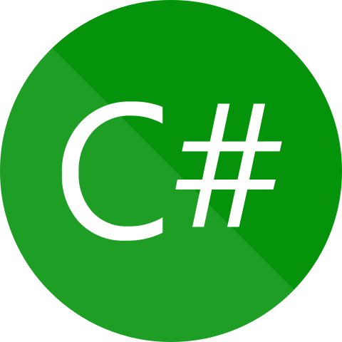
Can We Store Different Types Of Data In An Array Without Using Collection ?
Presenter: Mohammad Adil
C# Interview Questions
And Answers

Slide 2
Purpose Of This Video Series ??

Slide 3
Can We Store Different Types Of Data In An Array ?
Answer: Yes We can do that by creating an array of object type.

